Slide 1

How Do I Get Started in Open Source?
DevNexus 2018
https://github.com/cppwfs/DN2018
Notes:
Today’s goal is to give you a primer on how to contribute to a Open Source Project with a Spring focus. We will be walking you through steps it takes to contribute to an open source project as well as discuss with you the terminology.

Slide 2


Slide 3

Who Are You?
Notes:
All Spring projects are hosted on GitHub, so one of the prerequisites to contributing to the Spring family of open source projects is that you have a GitHub account.
How many of you have used git.
Do you have a have github account?
Have committed to an Opensource project?
If you have have you ever signed a CLA
How many of you can spell CLA
In 2018 is synomous with opensource . Have you ever contributed to another repo?

Slide 4
Why Contribute?
Notes:
For the project you are working on: Want a new Feature on a project you use. I.e a new Bell or whistle?
Found a bug fix and have a fix?
Or its taking the committers too long to get to an existing issue.
These are tactical to fix a known problem that affects your project/company
For Example My customer’s can’t order their taco’s at Tasty Taco’s because the Transaction model is busted in the new release

Slide 5

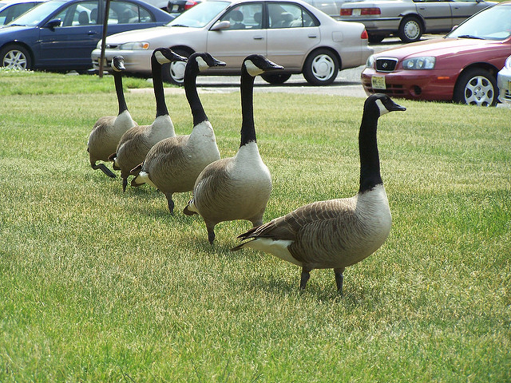

Why Contribute (cont) ?
Notes:
Join the community
Improve your knowledge
Looks good on a Resume’ You can show folks your github repo and refer to the code that you have added to a opensource project.
A number of folks joined Spring by being contributors to a Spring Project and became an expert.
https://flic.kr/p/MEALq
https://flic.kr/p/4zD8tf
https://flic.kr/p/nbAtrh

Slide 6

Terminology
Notes:
Join the community
Improve your knowledge
Looks good on a Resume’ You can show folks your github repo and refer to the code that you have added to a opensource project.
A number of folks joined Spring by being contributors to a Spring Project and became an expert.
https://flic.kr/p/MEALq
https://flic.kr/p/4zD8tf
https://flic.kr/p/nbAtrh

Slide 7

Roles - Contributor
Notes:
Contributor (being a good steward of the Open Source Community)
Everyone who has contributed something back to the project.
Documentation
Code:
Feature Adds
Bug Fixes
Build
Pom or build.gradle updates etc
Being a contributor means you can answer questions on Stack Overflow/gitter
You can speak on the OpenSource project at local user groups, meetups or conferences.
Many Spring employees got their position by speaking, answering question on SO, writing books

Slide 8

Issues & Questions
Notes:
Discuss difference between a question and an issue
What is an issue
Can be a feature or a bug
Can affect Code, Build or Docs
Insert issues on github issues or Jira
Questions
How do I do X, because documentation doesn’t cover it well (hint contribute ;-) )
Interaction between software doesn’t behave as it is supposed to.
Ask questions on SO or gitter
https://flic.kr/p/bNzhAT

Slide 9
Pull Request
Notes:
Pull requests let you tell others about changes you've pushed to a GitHub repository. Once a pull request is sent, interested parties can review the set of changes, discuss potential modifications, and even push follow-up commits if necessary.

Slide 10

Contributor License Agreement
Legal Stuff...
Breaking Into Open Source: https://vimeo.com/204987258
Notes:
One other little thing … the contributor agreement
defines the terms under which intellectual property has been contributed to a company/project, typically software under an open source license.
Always read it
Each one is different
If you are contributing on your company’s time ask first before contributing

Slide 11
Contributor Code of Conduct

Slide 12
Code Conventions

Slide 13
Roles - Committer
Notes:
Committer
A committer is an individual who is able to modify the source code of a particular piece of open-source software. To contribute source code on most large projects, one must make modifications and then "commit" those changes to a central repository such as Git (or CVS).(wikipedia)
How to become a committer (wikipedia)
Be one of the original developers
Be appointed by one of the original developers
Be successfully voted in by the community of committers
Responsibilities
Verify that the code meets coding standards
Verify that the code fixes the problem or adds prescribed functionality according to issue
Verify that it works
Make sure it has tests
Verify the build after PR has been applied
Merge code into repo
Own it!
https://twitter.com/jimgough/status/436948955281100800

Slide 14

Tools

Slide 15


Tools - Source Control

Slide 16

Tools - Open Issues

Slide 17


Tools - Ask Questions
Notes:
You can ask questions
You can also answer questions
Also make great opportunities to study the issue and get a deep dive into a project.
Be sure to tag your questions properly in StackOverflow

Slide 18


Tools - Build

Slide 19
A Day in the Life of a Contributor

Slide 20
Steps (First time)
Fork the project
Clone the project to local machine
Sign CLA
https://github.com/spring-projects/spring-integration/blob/master/CONTRIBUTING.adoc

Slide 21
Steps (Your Bug Fix)
Checkout topic branch
Do your magic
Commit with message
Push to github
Submit PR
Request changes
Review
Merge PR

Slide 22
Notes about commit messages
Checkout topic branch
Do your magic
Commit with message
Push to github
Submit PR
https://chris.beams.io/posts/git-commit/
Request changes
Review
Merge PR

Slide 23
Steps (Your Bug Fix)
Checkout topic branch
Do your magic
Commit with message
Push to github
Submit PR
Request changes
Review
Merge PR

Slide 25
Questions

Slide 26
Thank You!

